Slide 1
Applied Cryptography Collision-To-Second-Preimage, Collision-To-Second-Preimage, Merkle-Damgård construction
Liangfeng Zhang
School of Information Science and Technology
ShanghaiTech University

Slide 2
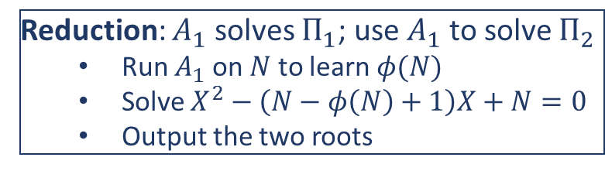
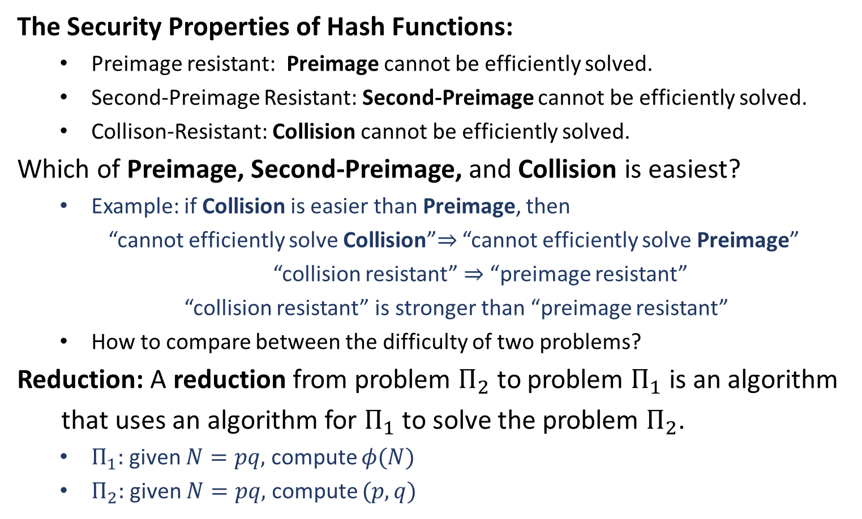
Comparisons of Security
The Security Properties of Hash Functions:
Preimage resistant: Preimage cannot be efficiently solved.
Second-Preimage Resistant: Second-Preimage cannot be efficiently solved.
Collison-Resistant: Collision cannot be efficiently solved.
Which of Preimage, Second-Preimage, and Collision is easiest?
Example: if Collision is easier than Preimage, then
“cannot efficiently solve Collision”$⇒$ “cannot efficiently solve Preimage”
“collision resistant” $⇒$ “preimage resistant”
“collision resistant” is stronger than “preimage resistant”
How to compare between the difficulty of two problems?
Reduction: A reduction from problem $Π_{2}$ to problem $Π_{1}$ is an algorithm
that uses an algorithm for $Π_{1}$ to solve the problem $Π_{2}$.
$Π_{1}:$ given $N=pq,$ compute $φ(N)$
$Π_{2}:$ given $N=pq,$ compute $(p,q)$
Which one is strongest?
Reduction: $A_{1}$ solves $Π_{1}$; use $A_{1}$ to solve $Π_{2}$
Run $A_{1}$ on $N$ to learn $φ(N)$
Solve $X^{2}−\left(N−φ\left(N\right)+1\right)X+N=0$
Output the two roots

Slide 3
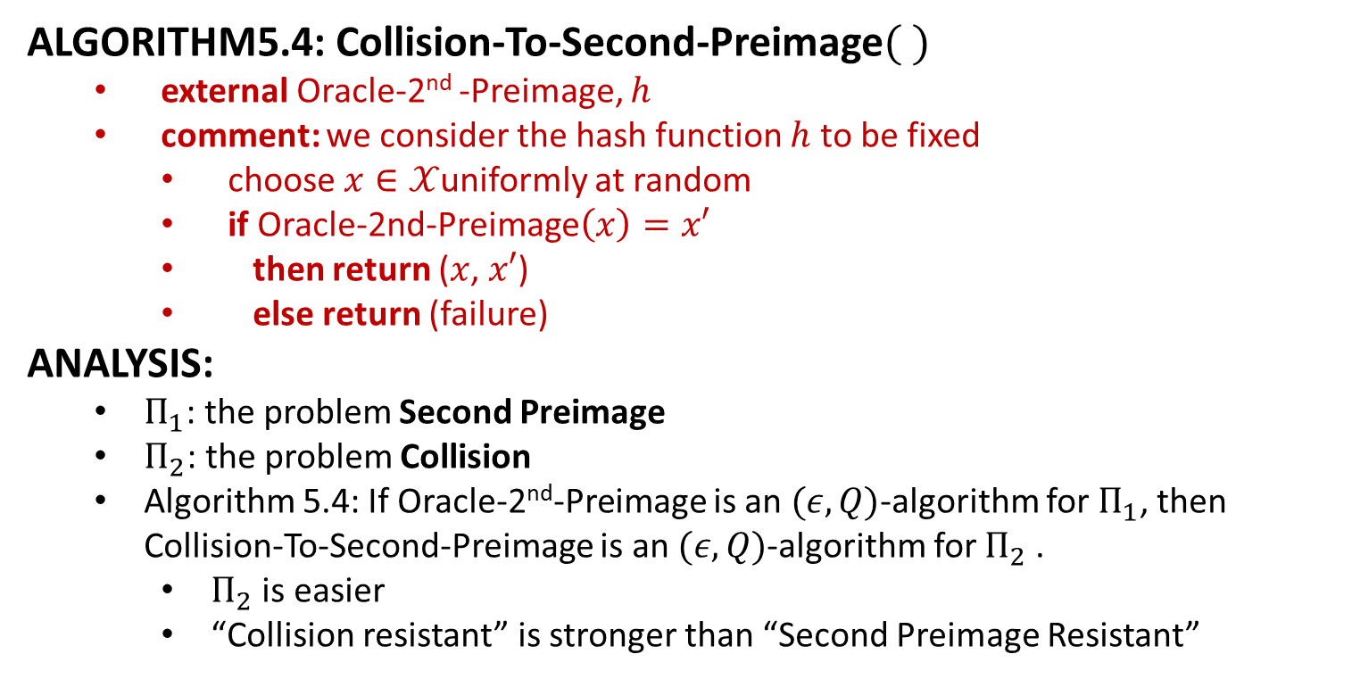
Comparisons of Security
ALGORITHM5.4: Collision-To-Second-Preimage$( )$
external Oracle-2nd -Preimage, $h$
comment: we consider the hash function $h$ to be fixed
choose $x∈𝒳$uniformly at random
if Oracle-2nd-Preimage$\left(x\right)=x′$
then return ($x$, $x′$)
else return (failure)
ANALYSIS:
$Π_{1}$: the problem Second Preimage
$Π_{2}$: the problem Collision
Algorithm 5.4: If Oracle-2nd-Preimage is an $(ε,Q)$-algorithm for $Π_{1}$, then Collision-To-Second-Preimage is an $(ε,Q)$-algorithm for $Π_{2}$.
$Π_{2}$ is easier
“Collision resistant” is stronger than “Second Preimage Resistant”

Slide 4
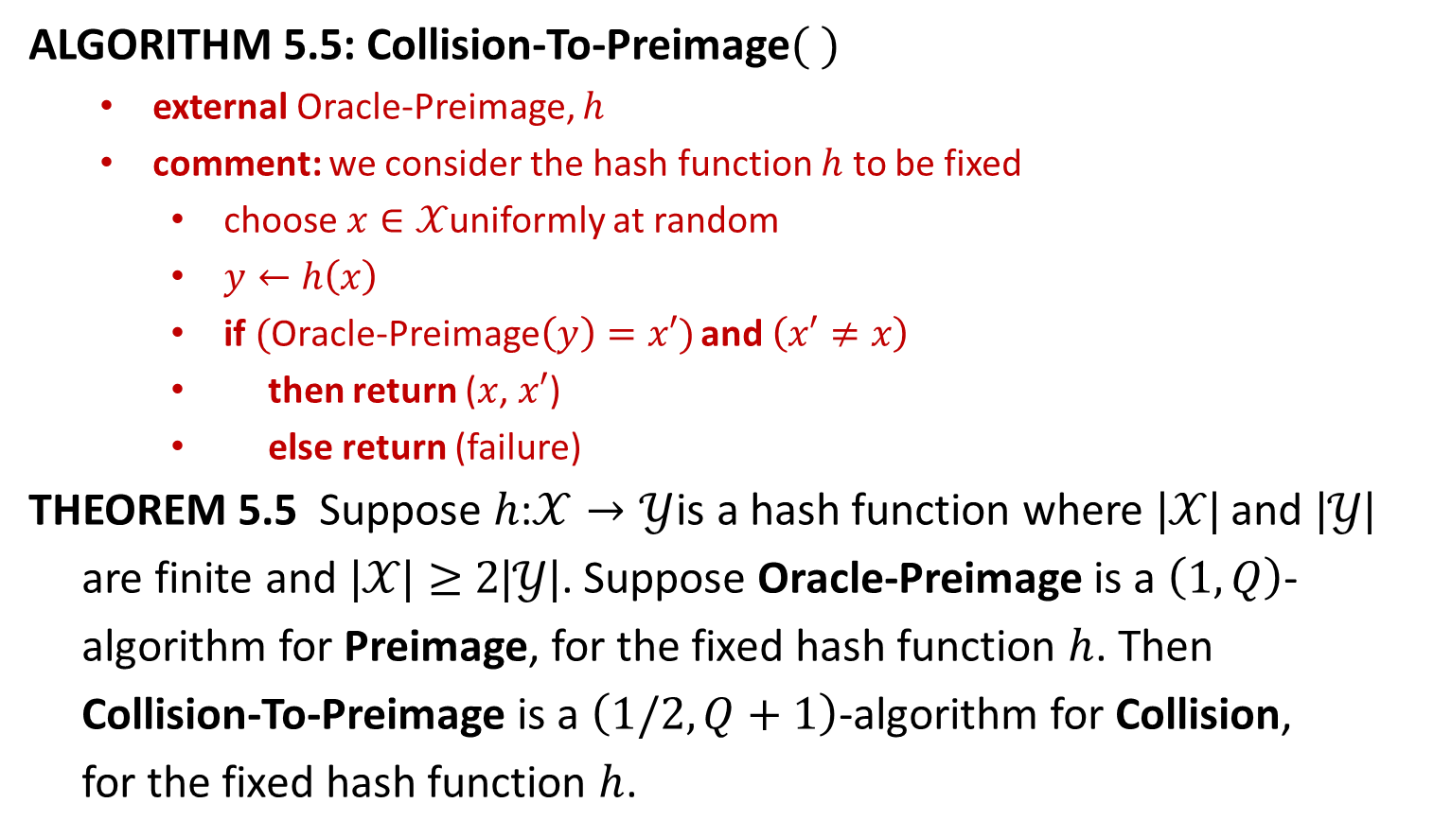
Comparisons of Security
ALGORITHM 5.5: Collision-To-Preimage$( )$
external Oracle-Preimage, $h$
comment: we consider the hash function $h$ to be fixed
choose $x∈𝒳$uniformly at random
$y←h\left(x\right)$
if $($Oracle-Preimage$\left(y\right)=x′)$ and $\left(x′≠x\right)$
then return ($x$, $x′$)
else return (failure)
THEOREM 5.5 Suppose $h\text{:}𝒳→𝒴$is a hash function where $|𝒳\text{|}$ and $|𝒴\text{|}$
are finite and $|𝒳\text{|}≥2|𝒴\text{|}$. Suppose Oracle-Preimage is a $\left(1,Q\right)$-
algorithm for Preimage, for the fixed hash function $h$. Then
Collision-To-Preimage is a $\left(1/2,Q+1\right)$-algorithm for Collision,
for the fixed hash function $h$.

Slide 5












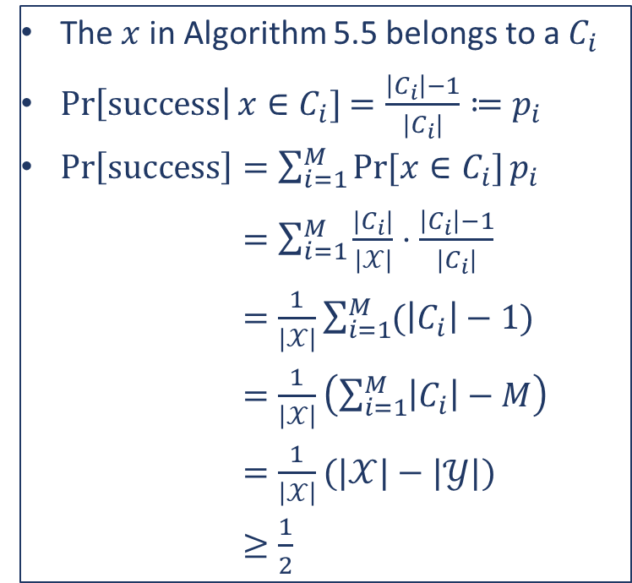
Comparisons of Security
The $x$ in Algorithm 5.5 belongs to a $C_{i}$
$\operatorname{Pr}\left[success\right|x∈C_{i}]$ $=\frac{\left|C_{i}\right|−1}{|C_{i}|}≔p_{i}$
$\operatorname{Pr}\left[success\right]=\sum_{i=1}^{M}{Pr⁡[x∈C_{i}]}p_{i}$
$=\sum_{i=1}^{M}{\frac{|C_{i}|}{|𝒳|}⋅\frac{\left|C_{i}\right|−1}{|C_{i}|}}$
$=\frac{1}{|𝒳|}\sum_{i=1}^{M}{(\left|C_{i}\right|−1)}$
$=\frac{1}{\left|𝒳\right|}\left(\sum_{i=1}^{M}{\left|C_{i}\right|}−M\right)$
$=\frac{1}{\left|𝒳\right|}(|𝒳|−|𝒴|)$
$≥\frac{1}{2}$
$$C_{1}$$
$$y_{1}$$
$$C_{2}$$
$$y_{2}$$
$$⋮$$
$$⋮$$
$$⋮$$
$$C_{M}$$
$$y_{M}$$
$$𝒳$$
$$|𝒳|≥2|𝒴|$$
$$𝒴$$

Slide 7

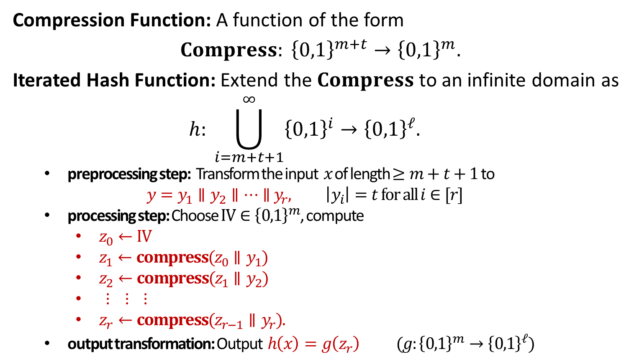
Iterated Hash Functions
Compression Function: A function of the form
$$Compress: {\left\{0,1\right\}}^{m+t}→{\left\{0,1\right\}}^{m}.$$
Iterated Hash Function: Extend the $Compress$ to an infinite domain as
$$h: \bigcup_{i=m+t+1}^{∞}{{\left\{0,1\right\}}^{i}}→{\left\{0,1\right\}}^{ℓ}.$$
preprocessing step: Transform the input $x$ of length $≥m+t+1$ to
$$y=y_{1}∥y_{2}∥⋯∥{ y}_{r}, \left|y_{i}\right|=t for all i∈[r]$$
processing step: Choose $IV∈{\left\{0,1\right\}}^{m}$, compute
$z_{0}←IV$
$z_{1}←compress(z_{0}∥y_{1})$
$z_{2}←compress(z_{1}∥y_{2})$
$⋮ ⋮ ⋮$
$z_{r}←compress(z_{r−1}∥y_{r}).$
output transformation: Output $h\left(x\right)=g\left(z_{r}\right)$ $(g:{\left\{0,1\right\}}^{m}→{\left\{0,1\right\}}^{ℓ})$
$$y=x|| pad(x)$$

Slide 8

















The Processing Step
$$y_{1}$$
$$y_{2}$$
$$y_{3}$$
$$⋯$$
$$y_{r}$$
$$y_{1}$$
$$y_{2}$$
$$y_{3}$$
$$⋯$$
$$y_{r}$$
compress
compress
compress
compress
compress
$$IV$$
$$z_{0}$$
$$z_{1}$$
$$z_{2}$$
$$⋯$$
$$z_{r−1}$$
$$z_{r}$$

Slide 10
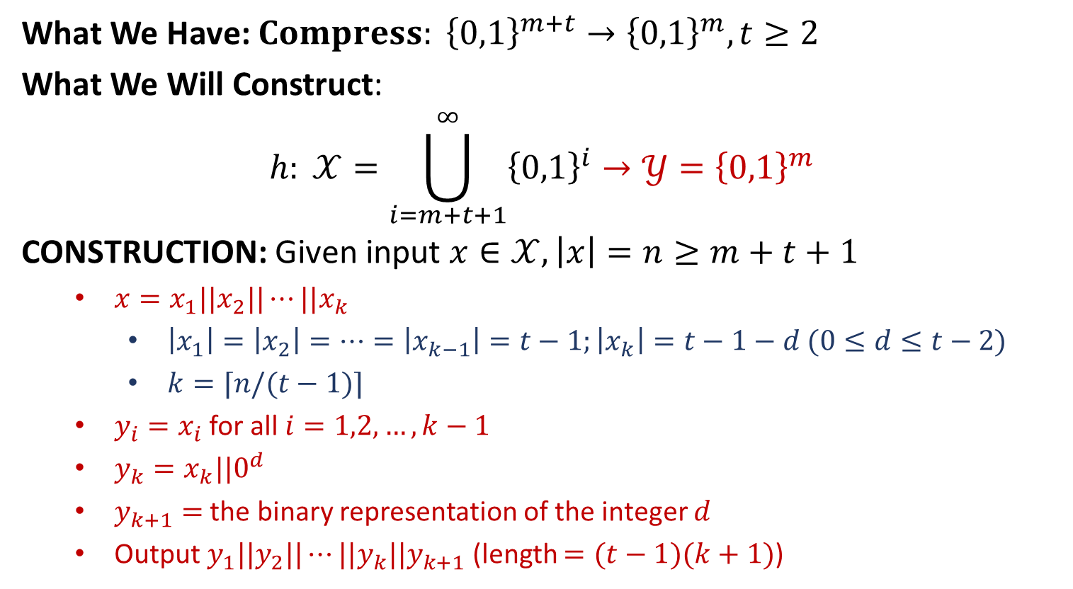
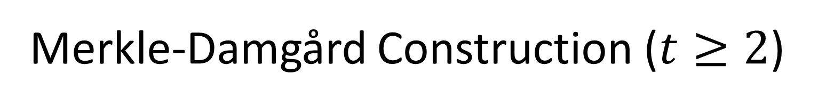
Merkle-Damgård Construction ($t≥2$)
What We Have: $Compress: {\left\{0,1\right\}}^{m+t}→{\left\{0,1\right\}}^{m}, t≥2$
What We Will Construct:
$$h: 𝒳=\bigcup_{i=m+t+1}^{∞}{{\left\{0,1\right\}}^{i}}→𝒴={\left\{0,1\right\}}^{m}$$
CONSTRUCTION: Given input $x∈𝒳, \left|x\right|=n≥m+t+1$
$x=x_{1}||x_{2}||⋯||x_{k}$
$\left|x_{1}\right|=\left|x_{2}\right|=⋯=\left|x_{k−1}\right|=t−1;\left|x_{k}\right|=t−1−d (0≤d≤t−2)$
$k=⌈n/(t−1)⌉$
$y_{i}=x_{i}$ for all $i=1,2,…,k−1$
$y_{k}=x_{k}||0^{d}$
$y_{k+1}=$ the binary representation of the integer $d$
Output $y_{1}||y_{2}||⋯||y_{k}||y_{k+1}$ (length $=(t−1)(k+1)$)

Slide 11









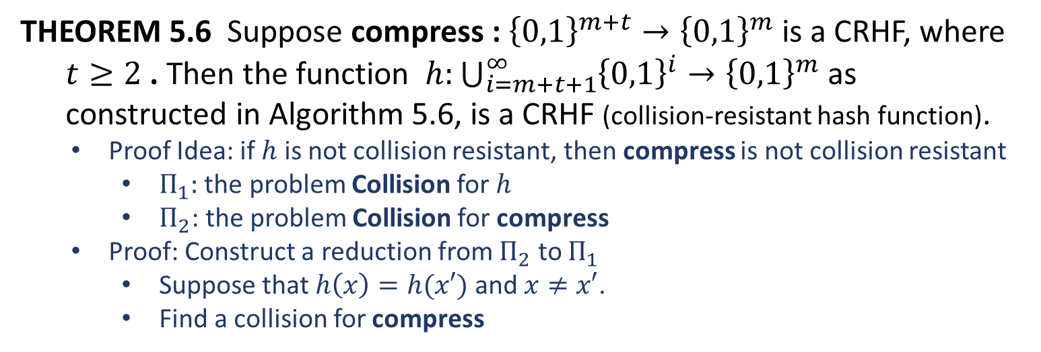




The Processing Step
$$0||y_{1}$$
$$1||y_{2}$$
$$1||y_{3}$$
$$⋯$$
$$1||y_{k+1}$$
$$IV$$
compress
compress
compress
compress
compress
$$h(x)$$
$$0^{m }$$
$$g_{1}$$
$$g_{2}$$
$$⋯$$
$$g_{k}$$
$$g_{k+1}$$
THEOREM 5.6 Suppose compress : ${\left\{0,1\right\}}^{m+t}→{\left\{0,1\right\}}^{m}$ is a CRHF, where
$t≥2$ . Then the function $h:\bigcup_{i=m+t+1}^{∞}{{\left\{0,1\right\}}^{i}→{\left\{0,1\right\}}^{m}}$ as
constructed in Algorithm 5.6, is a CRHF (collision-resistant hash function).
Proof Idea: if $h$ is not collision resistant, then compress is not collision resistant
$Π_{1}:$ the problem Collision for $h$
$Π_{2}$: the problem Collision for compress
Proof: Construct a reduction from $Π_{2}$ to $Π_{1}$
Suppose that $h\left(x\right)=h(x′)$ and $x≠x′$.
Find a collision for compress

Slide 12













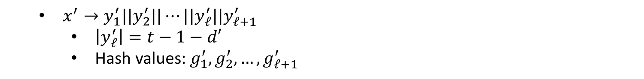




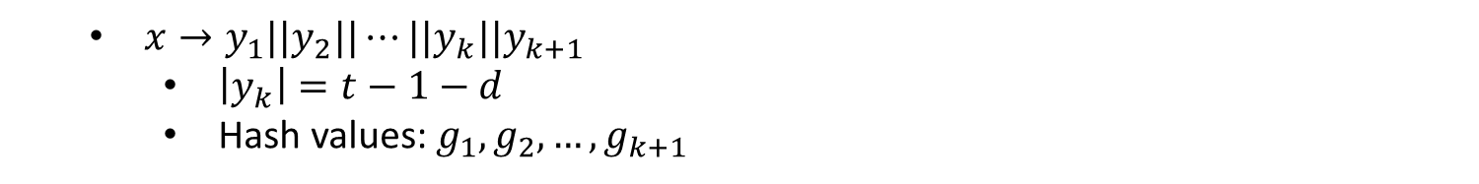









$$0||y_{1}$$
$$1||y_{2}$$
$$1||y_{3}$$
$$⋯$$
$$1||y_{k+1}$$
$$IV$$
compress
compress
compress
compress
compress
$$h(x)$$
$$0^{m }$$
$$g_{1}$$
$$g_{2}$$
$$⋯$$
$$g_{k}$$
$$g_{k+1}$$
$x→y_{1}||y_{2}||⋯||y_{k}||y_{k+1}$
$\left|y_{k}\right|=t−1−d$
Hash values: $g_{1},g_{2},…,g_{k+1}$
$$0||y_{1}^{′}$$
$$1||y_{2}^{′}$$
$$1||y_{3}^{′}$$
$$⋯$$
$$1||y_{ℓ+1}^{′}$$
$$IV$$
compress
compress
compress
compress
compress
$$h(x′)$$
$$0^{m }$$
$$g_{1}^{′}$$
$$g_{2}^{′}$$
$$⋯$$
$$g_{ℓ}^{′}$$
$$g_{ℓ+1}^{′}$$
$x^{′}→y_{1}^{′}||y_{2}^{′}||⋯||y_{ℓ}^{′}||y_{ℓ+1}^{′}$
$\left|y_{ℓ}^{′}\right|=t−1−d′$
Hash values: $g_{1}^{′},g_{2}^{′},…,g_{ℓ+1}^{′}$

Slide 13






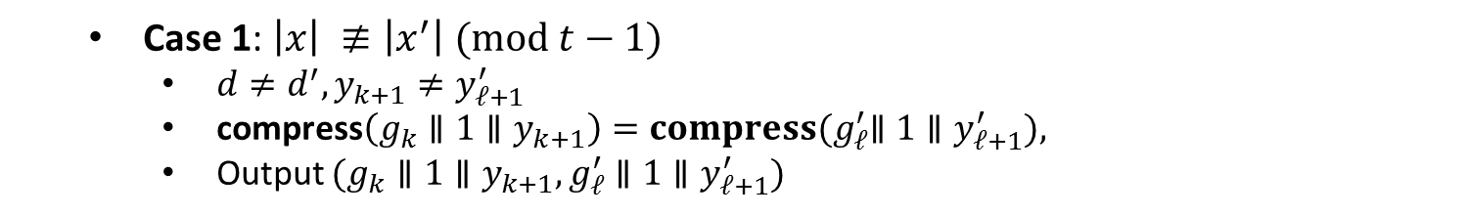



$$0||y_{1}$$
$$1||y_{2}$$
$$1||y_{3}$$
$$⋯$$
$$1||y_{k+1}$$
$$IV$$
compress
compress
compress
compress
compress
$$h(x)$$
$$0^{m }$$
$$g_{1}$$
$$g_{2}$$
$$⋯$$
$$g_{k}$$
$$g_{k+1}$$
$$0||y_{1}^{′}$$
$$1||y_{2}^{′}$$
$$1||y_{3}^{′}$$
$$⋯$$
$$1||y_{ℓ+1}^{′}$$
$$IV$$
compress
compress
compress
compress
compress
$$h(x′)$$
$$0^{m }$$
$$g_{1}^{′}$$
$$g_{2}^{′}$$
$$⋯$$
$$g_{ℓ}^{′}$$
$$g_{ℓ+1}^{′}$$
Case 1: $\left|x\right| ≢\left|x^{′}\right| (mod t−1)$
$d≠d^{′}, y_{k+1}≠y_{ℓ+1}^{′}$
compress$\left(g_{k}∥1∥y_{k+1}\right){=compress(g}_{ℓ}^{′}∥1∥y_{ℓ+1}^{′}),$
Output $(g_{k}∥1∥y_{k+1}, g_{ℓ}^{′}∥1∥y_{ℓ+1}^{′})$

Slide 14
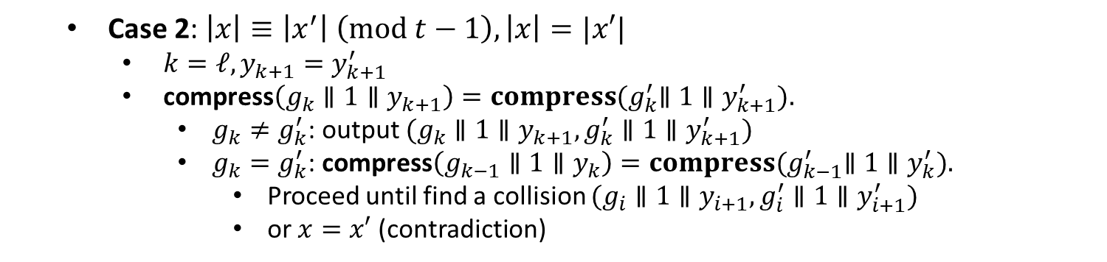
$$0||y_{1}$$
$$1||y_{2}$$
$$1||y_{3}$$
$$⋯$$
$$1||y_{k+1}$$
$$IV$$
compress
compress
compress
compress
compress
$$h(x)$$
$$0^{m }$$
$$g_{1}$$
$$g_{2}$$
$$⋯$$
$$g_{k}$$
$$g_{k+1}$$
$$0||y_{1}^{′}$$
$$1||y_{2}^{′}$$
$$1||y_{3}^{′}$$
$$⋯$$
$$1||y_{ℓ+1}^{′}$$
$$IV$$
compress
compress
compress
compress
compress
$$h(x′)$$
$$0^{m }$$
$$g_{1}^{′}$$
$$g_{2}^{′}$$
$$⋯$$
$$g_{ℓ}^{′}$$
$$g_{ℓ+1}^{′}$$
Case 2: $\left|x\right|≡\left|x^{′}\right| \left(mod t−1\right), \left|x\right|=|x′|$
$k=ℓ, y_{k+1}=y_{k+1}^{′}$
compress$\left(g_{k}∥1∥y_{k+1}\right){=compress(g}_{k}^{′}∥1∥y_{k+1}^{′}).$
$g_{k}≠g_{k}^{′}$: output $(g_{k}∥1∥y_{k+1},g_{k}^{′}∥1∥y_{k+1}^{′})$
$g_{k}=g_{k}^{′}$: compress$\left(g_{k−1}∥1∥y_{k}\right){=compress(g}_{k−1}^{′}∥1∥y_{k}^{′}).$
Proceed until find a collision $(g_{i}∥1∥y_{i+1},g_{i}^{′}∥1∥y_{i+1}^{′})$
or $x=x′$ (contradiction)

Slide 15
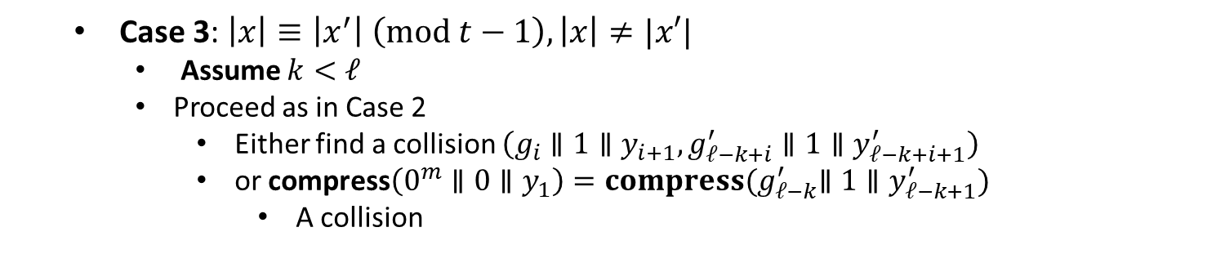
$$0||y_{1}$$
$$1||y_{2}$$
$$1||y_{3}$$
$$⋯$$
$$1||y_{k+1}$$
$$IV$$
compress
compress
compress
compress
compress
$$h(x)$$
$$0^{m }$$
$$g_{1}$$
$$g_{2}$$
$$⋯$$
$$g_{k}$$
$$g_{k+1}$$
$$0||y_{1}^{′}$$
$$1||y_{2}^{′}$$
$$1||y_{3}^{′}$$
$$⋯$$
$$1||y_{ℓ+1}^{′}$$
$$IV$$
compress
compress
compress
compress
compress
$$h(x′)$$
$$0^{m }$$
$$g_{1}^{′}$$
$$g_{2}^{′}$$
$$⋯$$
$$g_{ℓ}^{′}$$
$$g_{ℓ+1}^{′}$$
Case 3: $\left|x\right|≡\left|x^{′}\right| \left(mod t−1\right), \left|x\right|≠|x′|$
Assume $k<ℓ$
Proceed as in Case 2
Either find a collision $\left(g_{i}∥1∥y_{i+1},g_{ℓ−k+i}^{′}∥1∥y_{ℓ−k+i+1}^{′}\right)$
or compress$\left(0^{m}∥0∥y_{1}\right){=compress(g}_{ℓ−k}^{′}∥1∥y_{ℓ−k+1}^{′})$
A collision

